Slide 1


http://www.comp.nus.edu.sg/~cs2100/
Lecture #9
MIPS
Part III: Instruction Formats and Encoding

Slide 2

Lecture #9: MIPS Part 3: Instruction Formats
Overview and Motivation
MIPS Encoding: Basics
MIPS Instruction Classification
MIPS Registers (Recap)
R-Format
5.1 R-Format: Example
5.2 Try It Yourself #1

Slide 3

Lecture #9: MIPS Part 3: Instruction Formats
I-Format
6.1 I-Format: Example
6.2 Try It Yourself #2
6.3 Instruction Address: Overview
6.4 Branch: PC-Relative Addressing
6.5 Branch: Example
6.6 Try It Yourself #3
J-Format
7.1 J-Format: Example9
7.2 Branching Far Away: Challenge
Addressing Modes

Slide 4
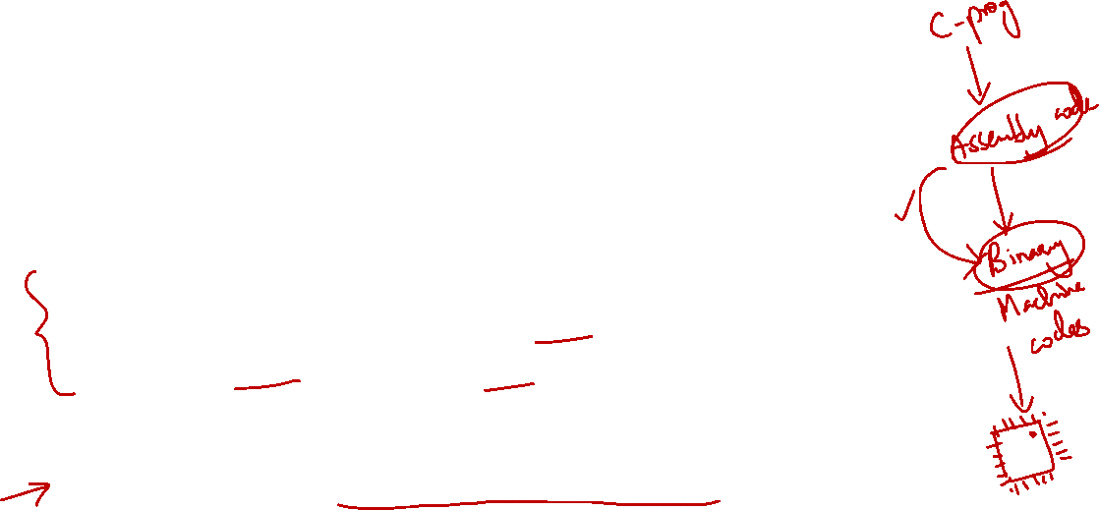
1. Overview and Motivation
Recap: Assembly instructions will be translated to machine code for actual execution
This section shows how to translate MIPS assembly code into binary patterns
Explains some of the “strange facts” from earlier:
Why is immediate limited to 16 bits?
Why is shift amount only 5 bits?
etc.
Prepare us to “build” a MIPS processor in later lectures!

Slide 5
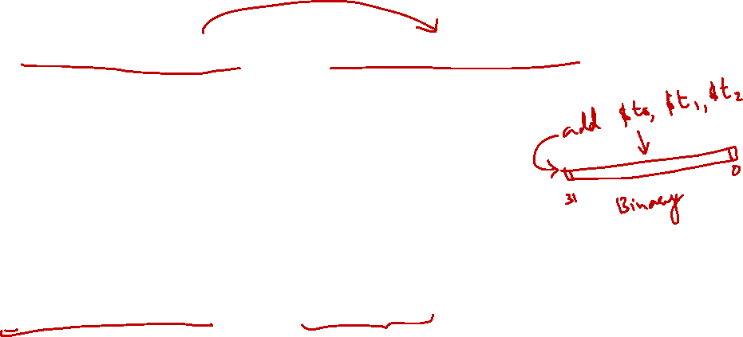
2. MIPS Encoding: Basics
Each MIPS instruction has a fixed-length of 32 bits
➔ All relevant information for an operation must be encoded with these bits!
Additional challenge:
To reduce the complexity of processor design, the instruction encodings should be as regular as possible
➔ Small number of formats, i.e. as few variations as possible

Slide 6
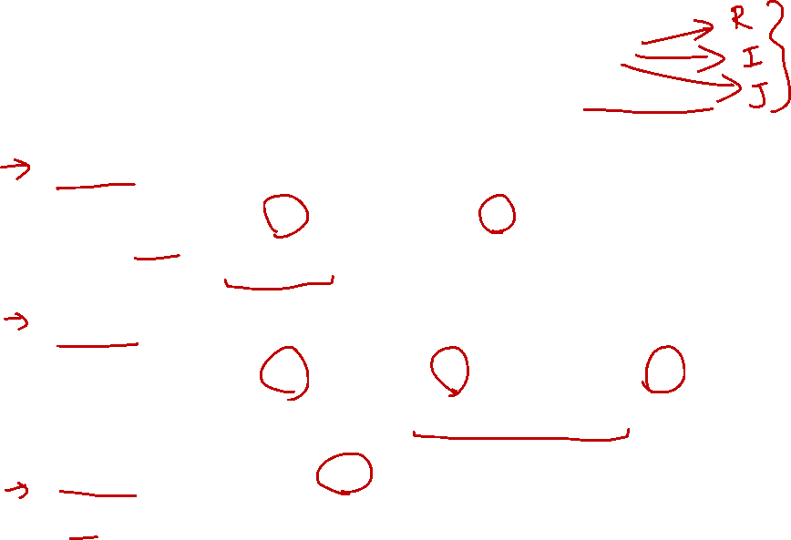
3. MIPS Instruction Classification
Instructions are classified according to their operands:
➔ Instructions with same operand types have same encoding
R-format (Register format: op $r1, $r2, $r3)
Instructions which use 2 source registers and 1 destination register
e.g. add, sub, and, or, nor, slt, etc
I-format (Immediate format: op $r1, $r2, Immd)
e.g. addi, andi, ori, slti, lw, sw, beq, bne, etc.
J-format (Jump format: op Immd)
j instruction uses only one immediate value
Instructions which use 1 source register, 1 immediate value and 1 destination register
Special cases: srl, sll, etc.

Slide 7

4. MIPS Registers (Recap)
For simplicity, register numbers ($0, $1, …, $31) will be used in examples here instead of register names
Name | Register number | Usage
$zero | 0 | Constant value 0
$v0-$v1 | 2-3 | Values for results and expression evaluation
$a0-$a3 | 4-7 | Arguments
$t0-$t7 | 8-15 | Temporaries
$s0-$s7 | 16-23 | Program variables
Name | Register number | Usage
$t8-$t9 | 24-25 | More temporaries
$gp | 28 | Global pointer
$sp | 29 | Stack pointer
$fp | 30 | Frame pointer
$ra | 31 | Return address
$at (register 1) is reserved for the assembler.
$k0-$k1 (registers 26-27) are reserved for the operation system.

Slide 8
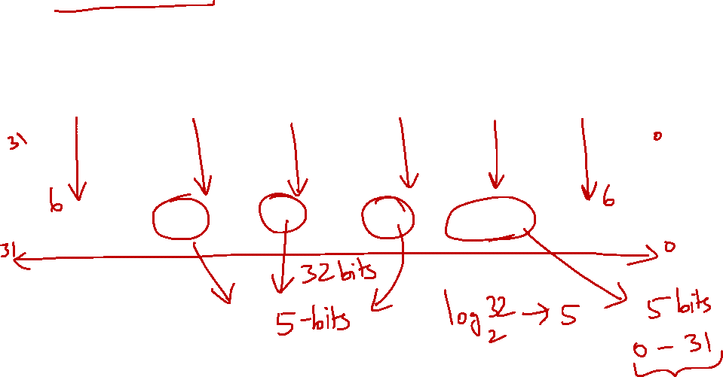
5. R-Format (1/2)
Define fields with the following number of bits each:
6 + 5 + 5 + 5 + 5 + 6 = 32 bits
6
5
5
5
5
6
Each field has a name:
opcode
rs
rt
rd
shamt
funct
Each field is an independent 5- or 6-bit unsigned integer
A 5-bit field can represent any number 0 – 31
A 6-bit field can represent any number 0 – 63
NOTE:
There are only 32 registers, so 5 bits for each register is enough.
Similarly, it is enough for shamt field since shifting 32 bits clears the entire register.

Slide 9
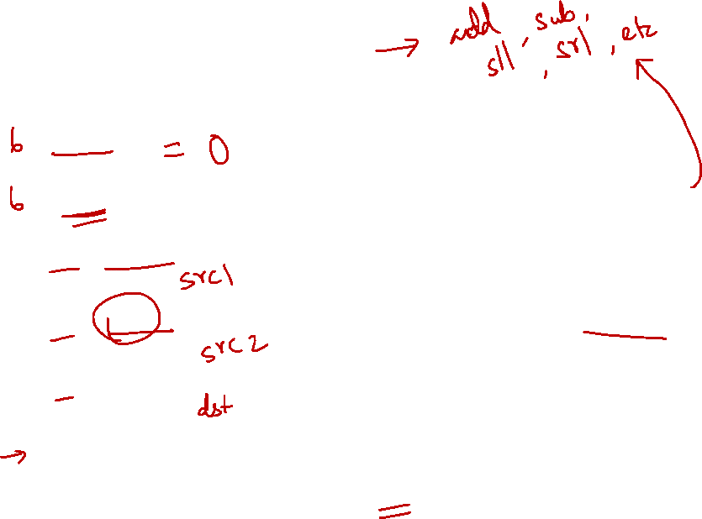
5. R-Format (2/2)
Fields | Meaning
opcode | - Partially specifies the instruction - Equal to 0 for all R-Format instructions
funct | - Combined with opcode exactly specifies the instruction
rs (Source Register) | - Specify register containing first operand
rt (Target Register) | - Specify register containing second operand
rd (Destination Register) | - Specify register which will receive result of computation
shamt | Amount a shift instruction will shift by 5 bits (i.e. 0 to 31) - Set to 0 in all non-shift instructions

Slide 10

5.1 R-Format: Example (1/3)
MIPS instruction
NOTE:
Find the value of opcode and funct from the MIPS green sheet that contains all information.
add $8, $9, $10
R-Format Fields | Value | Remarks
opcode | 0 | (textbook pg 94 - 101)
funct | 32 | (textbook pg 94 - 101)
rd | 8 | (destination register)
rs | 9 | (first operand)
rt | 10 | (second operand)
shamt | 0 | (not a shift instruction)

Slide 11

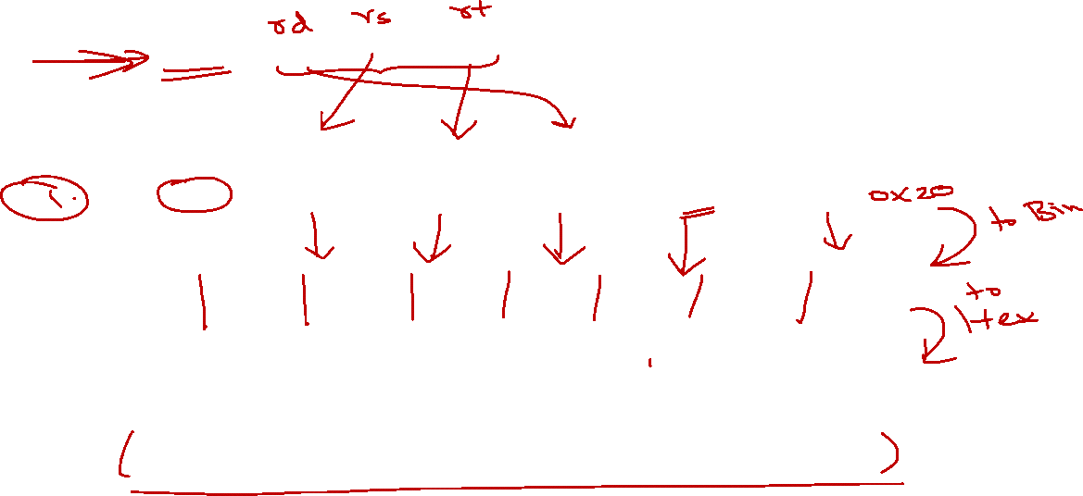
5.1 R-Format: Example (2/3)
MIPS instruction
add $8, $9, $10
Note the ordering of the 3 registers
Field representation in decimal:
opcode
rs
rt
rd
shamt
funct
0
9
10
8
0
32
Field representation in binary:
000000
01001
01010
01000
00000
100000
Split into 4-bit groups for hexadecimal conversion:
0000
0001
0010
1010
0100
0000
0010
0000
0₁₆
1₁₆
2₁₆
A₁₆
4₁₆
0₁₆
2₁₆
0₁₆

Slide 12
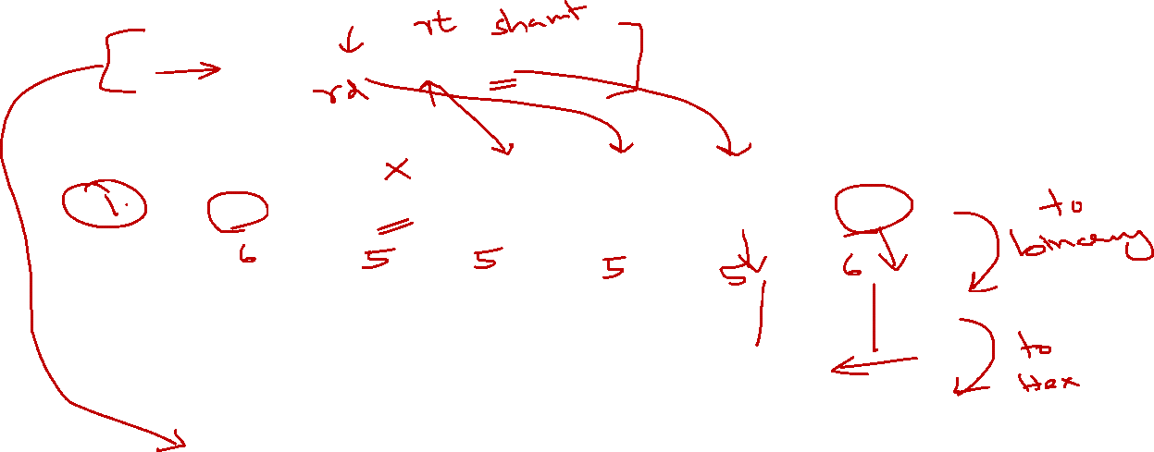
5.1 R-Format: Example (3/3)
MIPS instruction
sll $8, $9, 4
Note the placement of the source register
Field representation in decimal:
opcode
rs
rt
rd
shamt
funct
0
0
9
8
4
0
Field representation in binary:
000000
00000
01001
01000
00100
000000
Split into 4-bit groups for hexadecimal conversion:
0000
0000
0000
1001
0100
0001
0000
0000
0₁₆
0₁₆
0₁₆
9₁₆
4₁₆
1₁₆
0₁₆
0₁₆

Slide 13
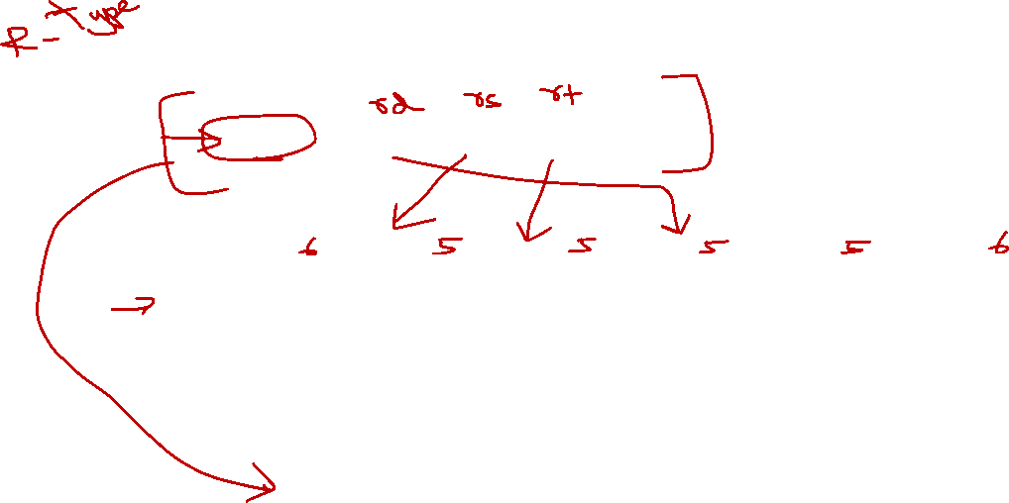
5.2 Try It Yourself #1
MIPS instruction
add $10, $7, $5
Field representation in decimal:
opcode
rs
rt
rd
shamt
funct
0
7
5
10
0
32
Field representation in binary:
000000
00111
00101
01010
00000
100000
Hexadecimal representation of instruction:
0 0 E 5 5 0 2 0₁₆


Slide 14
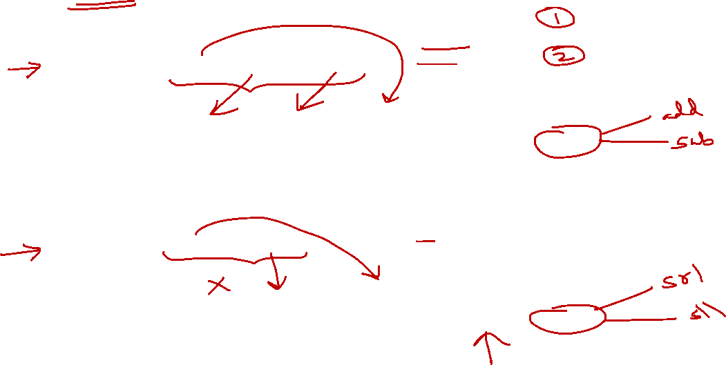
5. R-Format: Summary
MIPS instruction
NOTE:
opcode is always 0
shamt is always 0
arith is arithmetic operation
arith $rd, $rs, $rt
opcode
rs
rt
rd
shamt
funct
0
rs
rt
rd
0
XX
MIPS instruction
NOTE:
opcode is always 0
rs is always 0
shift is shift operation
shift $rd, $rt, shamt
opcode
rs
rt
rd
shamt
funct
0
0
rt
rd
shamt
XX

Slide 15
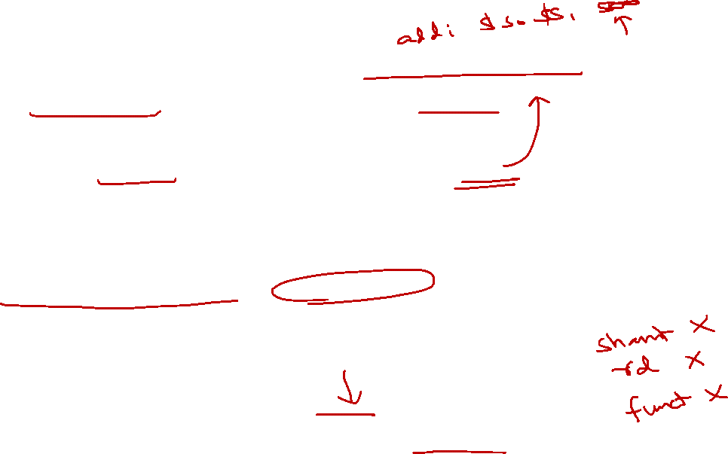
6. I-format (1/4)
What about instructions with immediate values?
5-bit shamt field can only represent 0 to 31
Immediates may be much larger than this
e.g. lw, sw instructions require bigger offset
Compromise: Define a new instruction format partially consistent with R-format:
If instruction has immediate, then it uses at most 2 registers
NOTE:
The reason why we want to keep some fields in the same position (e.g., opcode) is that by looking at the binary, we can quickly identify the instruction format.
Also, we ensure that retrieving rs and rt will be consistent across R-format and I-format.

Slide 16
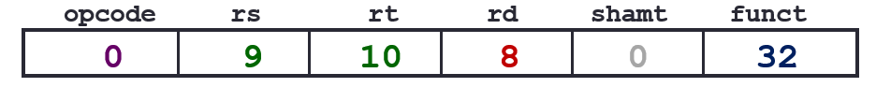
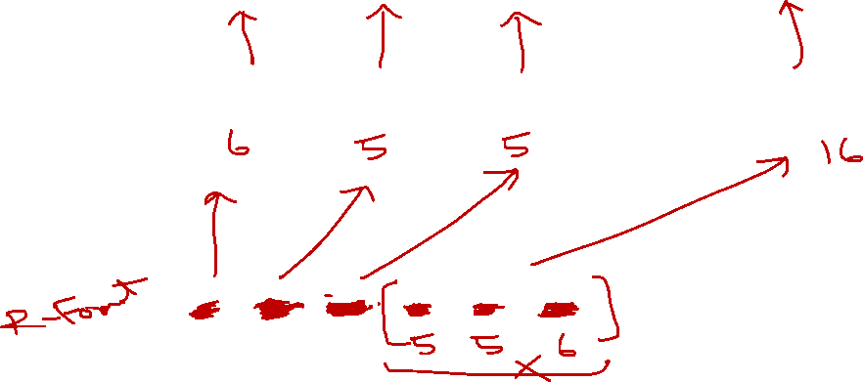
6. I-format (2/4)
Define fields with the following number of bits each:
6 + 5 + 5 + 16 = 32 bits
6
5
5
16
Again, each field has a name:
opcode
rs
rt
immediate
Only one field is inconsistent with R-format.
opcode, rs, and rt are still in the same locations.
NOTE:
We merge rd, shamt and funct to form a 16-bit field used for a constant value (immediate).
That is, 5 + 5 + 6 = 16 bits. Just nice!

Slide 17
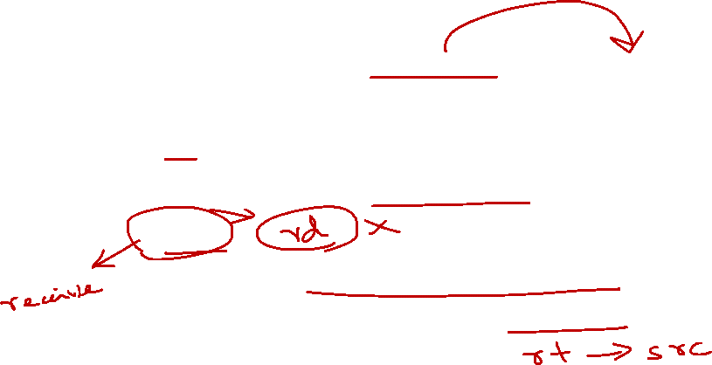
6. I-format (3/4)
opcode
Since there is no funct field, opcode uniquely specifies an instruction
rs
specifies the source register operand (if any)
rt
specifies register to receive result
note the difference from R-format instructions
Continue on next slide……

Slide 18
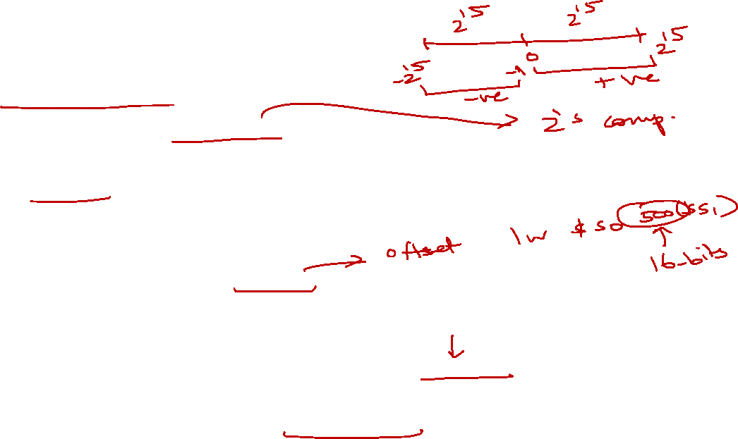
6. I-format (4/4)
immediate:
Treated as a signed integer
Except for bitwise operations (andi, ori, xori)
16 bits → can be used to represent a constant up to 2¹⁶ different values
Large enough to handle:
The offset in a typical lw or sw
Most of the values used in the addi, slti instructions
NOTE:
This should answer why we cannot put 32-bit constants in the instruction. Because the instruction itself is only 32-bit wide. So we can only use parts of it. Plus, we still need to encode opcode, rs and rt.

Slide 19

6.1 I-format: Example (1/2)
MIPS instruction
addi $21, $22, -50
I-Format Fields | Value | Remarks
opcode | 8 | (textbook pg 94 - 101)
rs | 22 | (the only source register)
rt | 21 | (target register)
immediate | -50 | (in base 10)

Slide 20
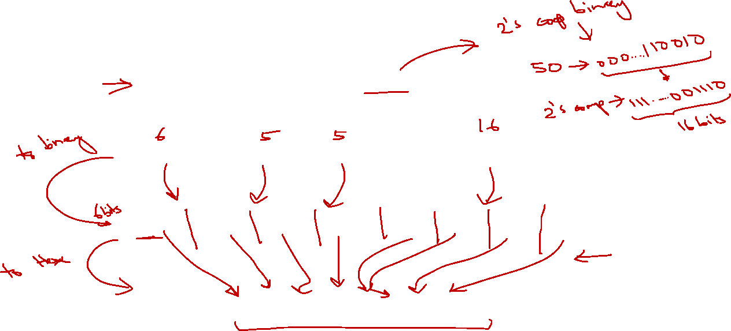
6.1 I-format: Example (2/2)
MIPS instruction
addi $21, $22, -50
Field representation in decimal:
8
22
21
-50
Field representation in binary:
001000
10110
10101
1111111111001110
Hexadecimal representation of instruction:
2 2 D 5 F F C E₁₆

Slide 21
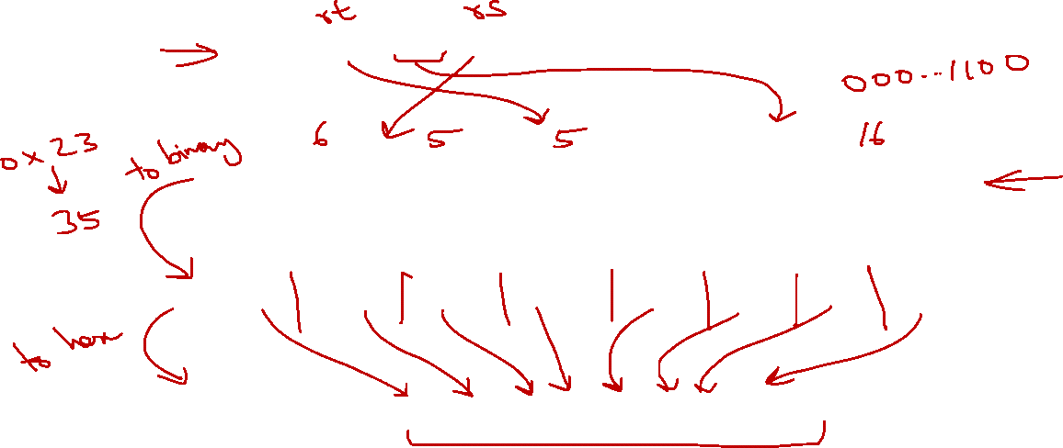
6.2 Try It Yourself #2
MIPS instruction
lw $9, 12($8)
Field representation in decimal:
opcode
rs
rt
immediate
35
8
9
12
Field representation in binary:
100011
01000
01001
0000000000001100
Hexadecimal representation of instruction:
8 D 0 9 0 0 0 C₁₆


Slide 22
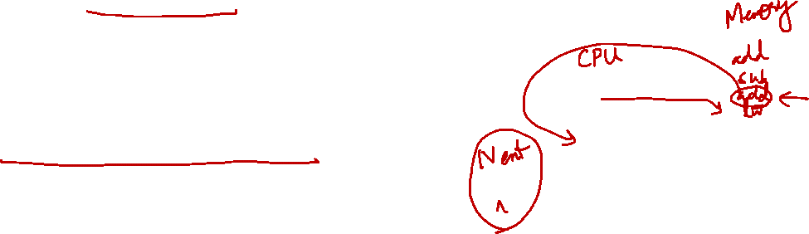
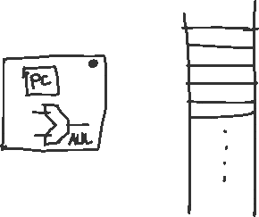
6.3 Instruction Address: Overview
As instructions are stored in memory, they too have addresses
Control flow instructions uses these addresses
E.g. beq, bne, j
As instructions are 32-bit long, instruction addresses are word-aligned as well
Program Counter (PC)
A special register that keeps address of instruction being executed in the processor

Slide 23
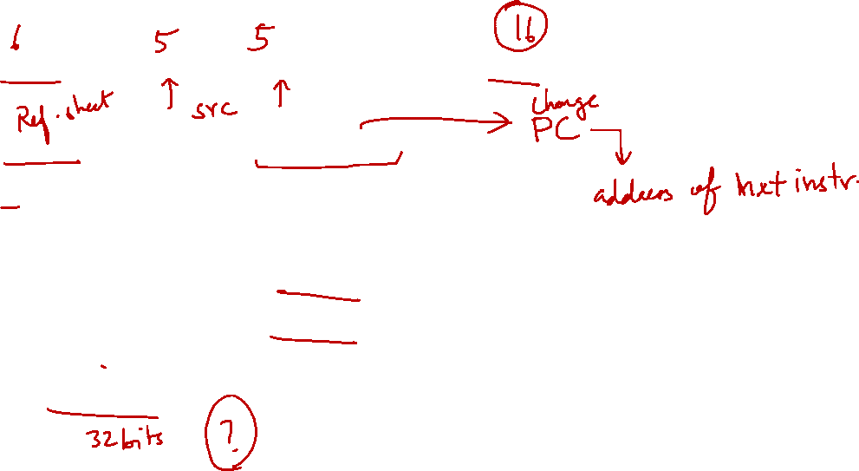
6.4 Branch: PC-Relative Addressing (1/5)
Use I-Format
opcode
rs
rt
immediate
opcode specifies beq, bne
rs and rt specify registers to compare
What can immediate specify?
Immediate is only 16 bits
Memory address is 32 bits
➔ immediate is not enough to specify the entire target address!

Slide 24
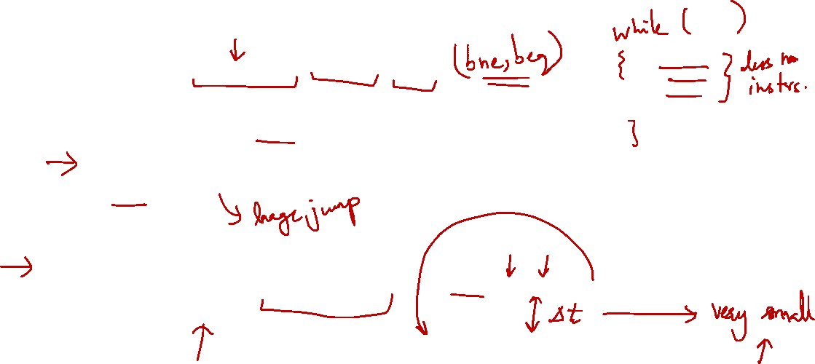
6.4 Branch: PC-Relative Addressing (2/5)
How do we usually use branches?
Answer: if-else, while, for
Loops are generally small:
Typically up to 50 instructions
Unconditional jumps are done using jump instructions (j), not the branches
Conclusion: A branch often changes PC by a small amount
PC
beq $9, $8, End
End
End: …………………

Slide 25
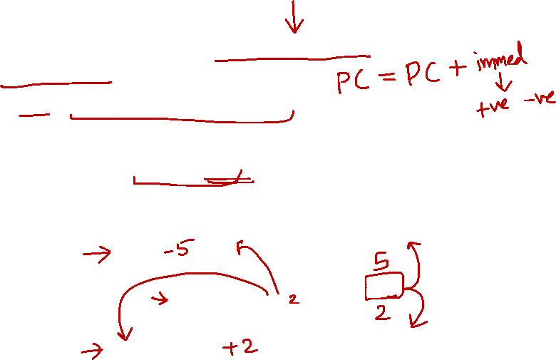
6.4 Branch: PC-Relative Addressing (3/5)
Solution:
Specify target address relative to the PC
Target address is generated as:
PC + the 16-bit immediate field
The immediate field is a signed two’s complement integer
➔ Can branch to ± 2¹⁵ bytes from the PC:
Should be enough to cover most loops
End2
End2: …………………
-
PC
beq $9,$8,End
+
End
End: …………………

Slide 26
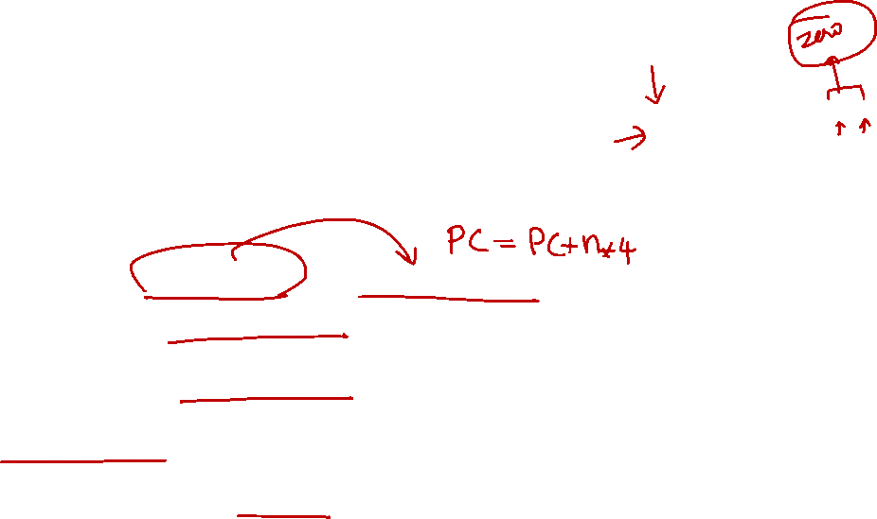
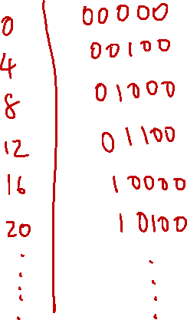
6.4 Branch: PC-Relative Addressing (4/5)
Can the branch target range be enlarged?
Observation: Instructions are word-aligned
Number of bytes to add to the PC will always be a multiple of 4.
➔ Interpret the immediate as number of words, i.e. automatically multiplied by 4₁₀ (100₂)
➔ Can branch to ± 2¹⁵ words from the PC
i.e. ± 2¹⁷ bytes from the PC
We can now branch 4 times farther!

Slide 27
6.4 Branch: PC-Relative Addressing (5/5)
Branch calculation:
Observations:
immediate field specifies the number of words to jump, which is the same as the number of instructions to “skip over”
immediate field can be positive or negative
Due to hardware design, add immediate to (PC+4), not to PC (more in later topic)
If the branch is not taken:
PC = PC + 4
(PC + 4 is address of next instruction)
If the branch is taken:
PC = (PC + 4) + (immediate × 4)

Slide 28
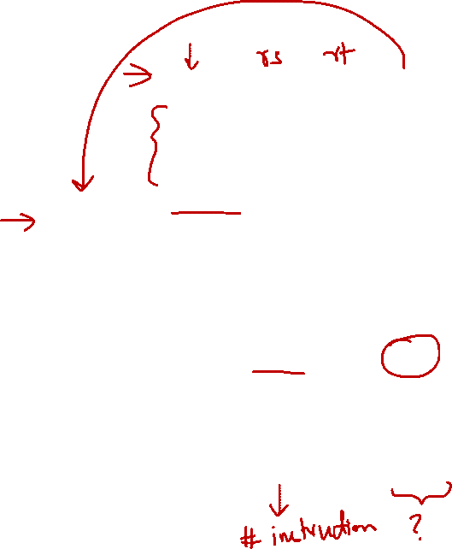
6.5 Branch: Example (1/3)
Loop: beq $9, $0, End # rlt addr: 0
add $8, $8, $10 # rlt addr: 4
addi $9, $9, -1 # rlt addr: 8
j Loop # rlt addr: 12
End: # rlt addr: 16
beq is an I-Format instruction ➔
I-Format Fields | Value | Remarks
opcode | 4
rs | 9 | (first operand)
rt | 0 | (second operand)
immediate | ??? | (in base 10)

Slide 29
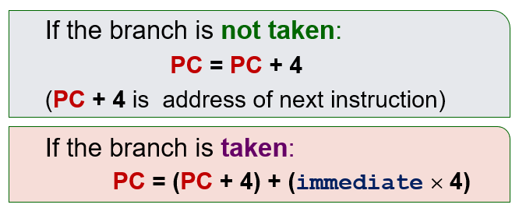
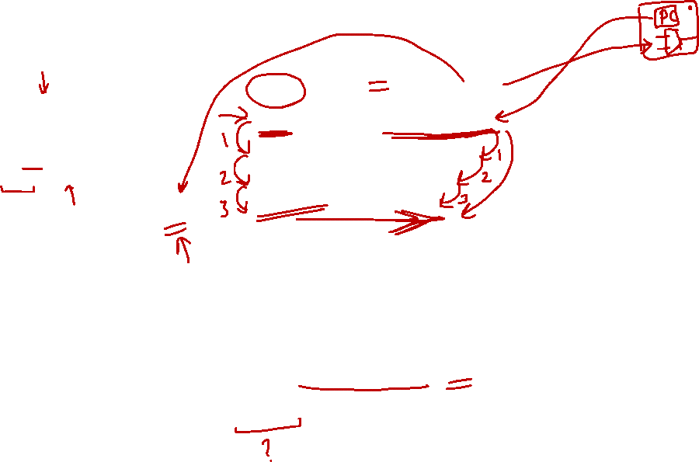
6.5 Branch: Example (2/3)
Loop: beq $9, $0, End # rlt addr: 0
add $8, $8, $10 # rlt addr: 4
addi $9, $9, -1 # rlt addr: 8
j Loop # rlt addr: 12
End: # rlt addr: 16
immediate field:
Number of instructions to add to (or subtract from) the PC, starting at the instruction following the branch
In beq case, immediate = 3
End = (PC + 4) + (immediate × 4)

Slide 30

6.5 Branch: Example (3/3)
Loop: beq $9, $0, End # rlt addr: 0
add $8, $8, $10 # rlt addr: 4
addi $9, $9, -1 # rlt addr: 8
j Loop # rlt addr: 12
End: # rlt addr: 16
Field representation in decimal:
opcode
rs
rt
immediate
4
9
0
3
Field representation in binary:
000100
01001
00000
0000000000000011

Slide 31
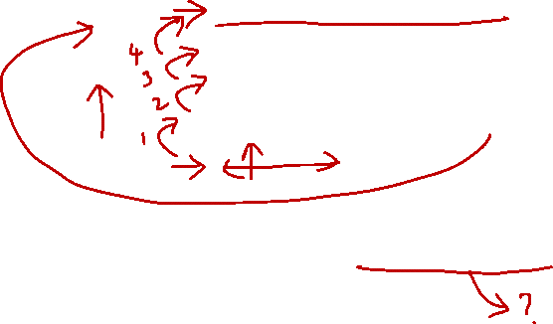
6.6 Try It Yourself #3
Loop: beq $9, $0, End # rlt addr: 0
add $8, $8, $10 # rlt addr: 4
addi $9, $9, -1 # rlt addr: 8
beq $0, $0, Loop # rlt addr: 12
End: # rlt addr: 16
What would be the immediate value for the second beq instruction?
Answer: – 4


Slide 32
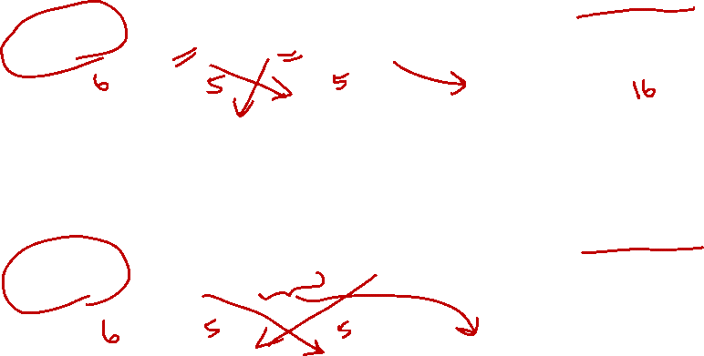
6. I-Format: Summary
MIPS instruction
NOTE:
C16_{2s} is in 2s complement
arith is arithmetic operation
arith $rt, $rs, C16_{2s}
opcode
rs
rt
immediate
XX
rs
rt
C16_{2s}
MIPS instruction
NOTE:
C16_{2s} is in 2s complement
ld/st is a load or store operation
ld/st $rt, C16_{2s}($rs)
opcode
rs
rt
immediate
XX
rs
rt
C16_{2s}

Slide 33
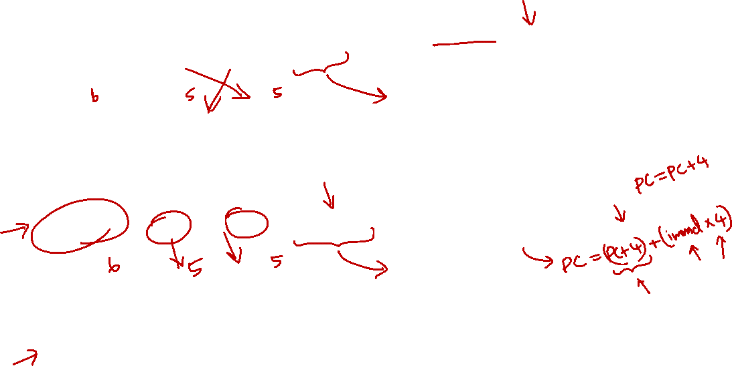
6. I-Format: Summary
MIPS instruction
NOTE:
C16 is raw binary (no negative)
logic is logical operation (bitwise operation)
logic $rt, $rs, C16
opcode
rs
rt
immediate
XX
rs
rt
C16
MIPS instruction
NOTE:
branch is a branch operation
label is converted to number first (PC-relative addressing)
branch $rs, $rt, label
opcode
rs
rt
immediate
XX
rs
rt
label
NOTE:
please note the position of rs and rt here.
The first register is NOT rt but is rs instead!

Slide 34
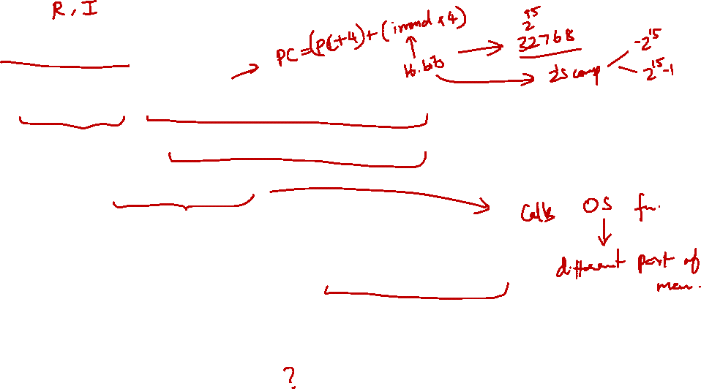
7. J-Format (1/5)
For branches, PC-relative addressing was used:
Because we do not need to branch too far
For general jumps (j):
We may jump to anywhere in memory!
The ideal case is to specify a 32-bit memory address to jump to
Unfortunately, we can’t (☹ why?)

Slide 35
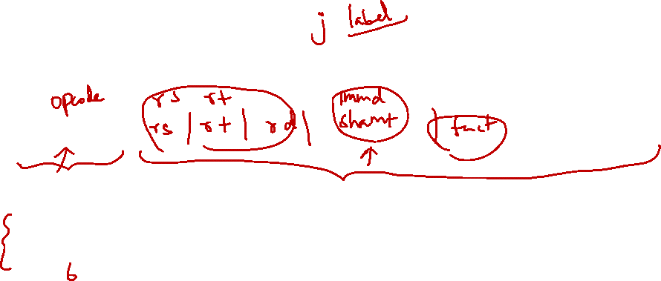
7. J-Format (2/5)
Define fields of the following number of bits each:
6 bits
26 bits
As usual, each field has a name:
opcode
target address
Keep opcode field identical to R-format and I-format for consistency
Combine all other fields to make room for larger target address

Slide 36
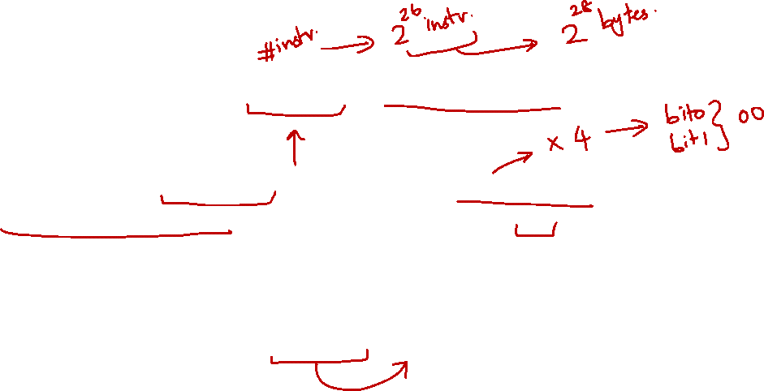
7. J-Format (3/5)
We can only specify 26 bits of 32-bit address
Optimisation:
Just like with branches, jumps will only jump to word-aligned addresses, so last 2 bits are always 00
So, let’s assume the address ends with ’00’ and leave them out
➔ Now we can specify 28 bits of 32-bit address

Slide 37
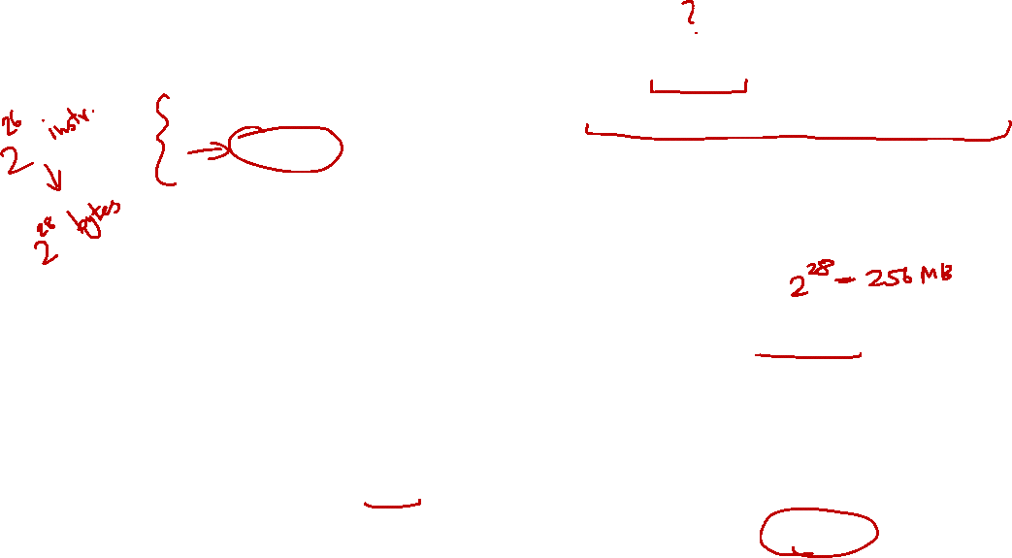
7. J-Format (4/5)
Where do we get the other 4 bits?
MIPS choose to take the 4 most significant bits from PC+4 (the next instruction after the jump instruction)
➔ This means that we cannot jump to anywhere in memory, but it should be sufficient most of the time
Question:
What is the maximum jump range?
256MB boundary
Special instruction if the program straddles 256MB boundary
Look up jr instruction if you are interested
Target address is specified through a register

Slide 38
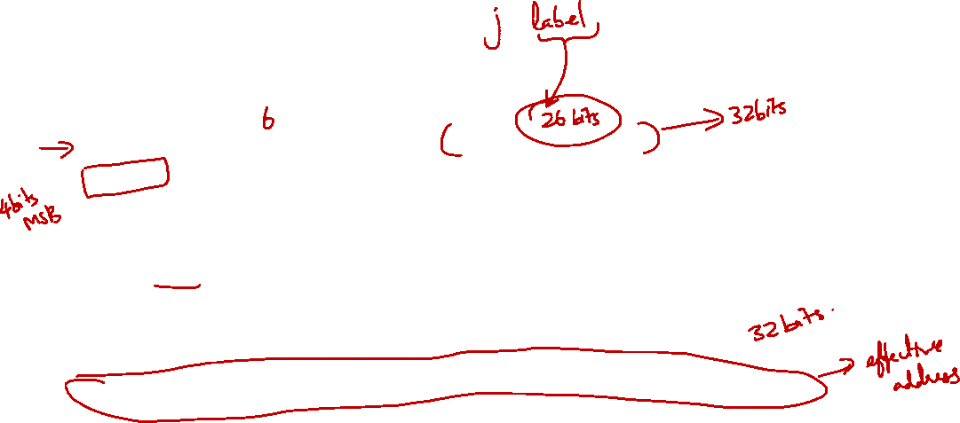
7. J-Format (5/5)
Summary: Given a Jump instruction
32bit PC
opcode
target address
1010………
000010
00001111000011110000111100
The rest of the PC+4 is ignored!
Jumps To
1010
00001111000011110000111100
00
Most significant 4bits of PC+4
26bits Target address specified in instruction
Default 2bit "00" for word address

Slide 39
7. 256MB Boundary
Due to the use of the first 4-bits from the PC (i.e., the memory address of the currently executed instruction), we can only jump within our block.
If you are at the top of the boundary, you cannot jump up.
If you are at the bottom of the boundary, you cannot jump down.
Can you figure out the address of the top and the bottom? (disscuss in forum)
0x 0000 0000
256MB
0x 1000 0000
256MB
0x 2000 0000
256MB
0x 3000 0000
256MB

Slide 40
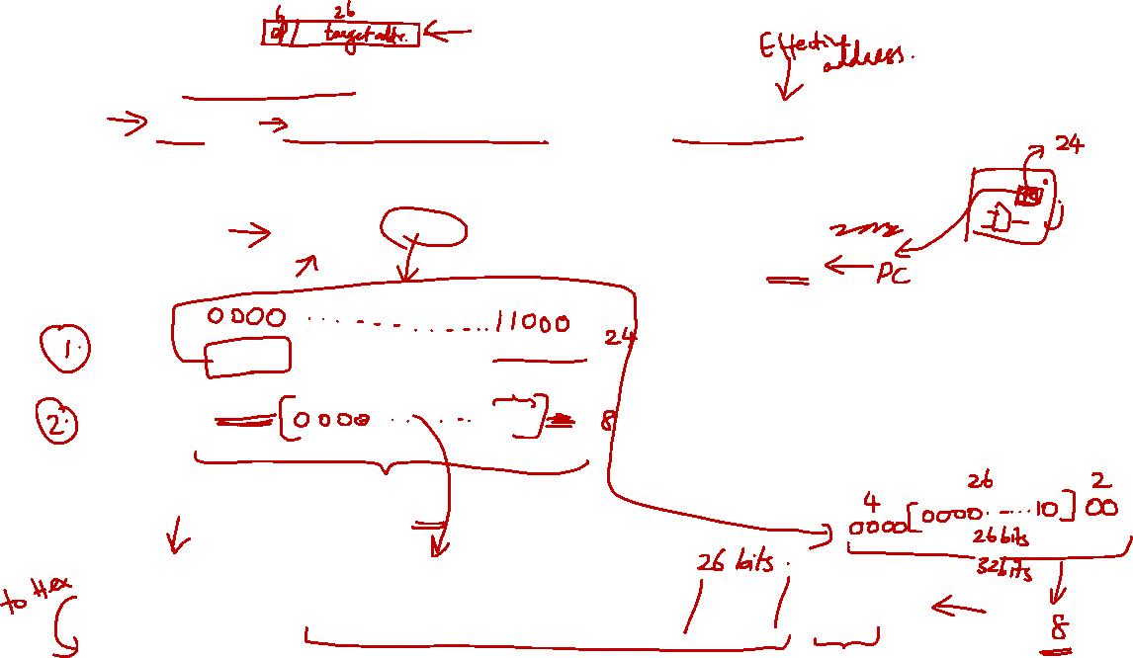
7.1 J-Format: Example
Loop: beq $9, $0, End # addr: 8
add $8, $8, $10 # addr: 12
addi $9, $9, -1 # addr: 16
j Loop # addr: 20
End: # addr: 24
jump target
PC
PC
0000………………………..10100
Check your understanding by constructing the new PC value
Address to jump to
0000………………………..01000
immediate =2 (26 bits)
opcode
target address
000010
00000000000000000000000010

Slide 41
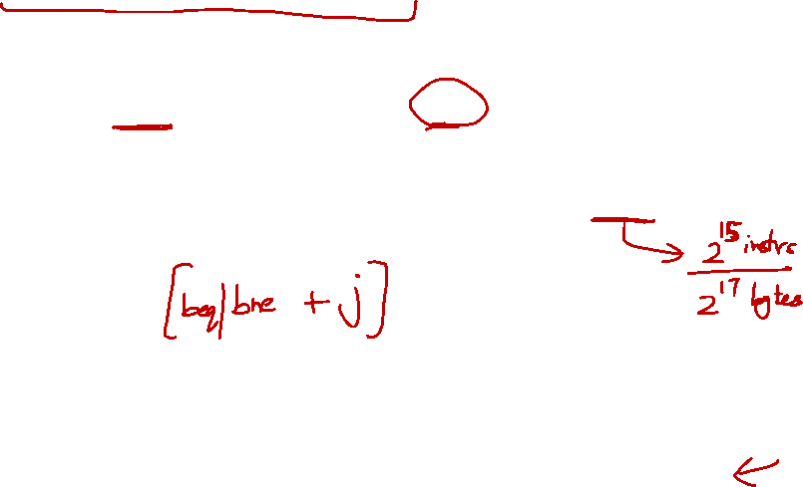
7.2 Branching Far Way
Given the instruction beq $s0, $s1, L1 Assume that the address L1 is farther away from the PC than what can be supported by beq and bne instructions
Challenge:
Construct an equivalent code sequence with the help of unconditional (j) and conditional branch (beq, bne) instructions to accomplish this far away branching
NOTE:
Discuss in forum

Slide 42
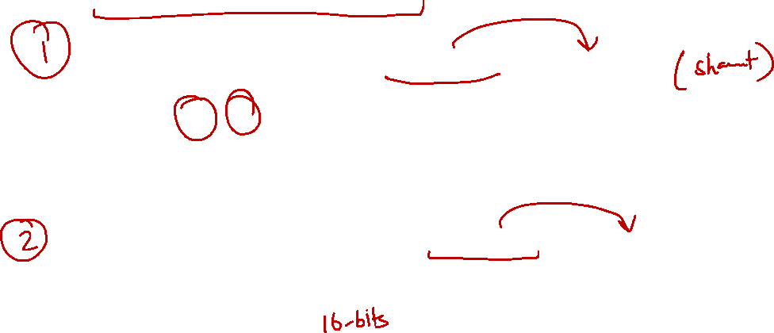
8. Addressing Modes (1/3)
Register addressing: operand is a register
op
rs
rt
rd
funct
Register
MIPS:
add, sub, and, or, xor, nor, slt, sll, srl
Immediate addressing: operand is a constant within the instruction itself (addi, andi, ori, slti)
op
rs
rt
immediate
MIPS:
addi, andi, ori, xori, slti

Slide 43
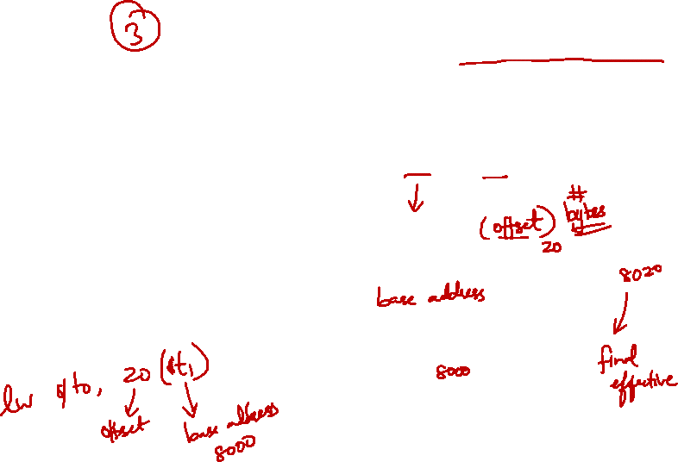
8. Addressing Modes (2/3)
Base addressing (displacement addressing): operand is at the memory location whose address is sum of a register and a constant in the instruction (lw, sw)
Memory
op
rs
rt
Address
MIPS:
lw, sw
Register
+
word

Slide 44
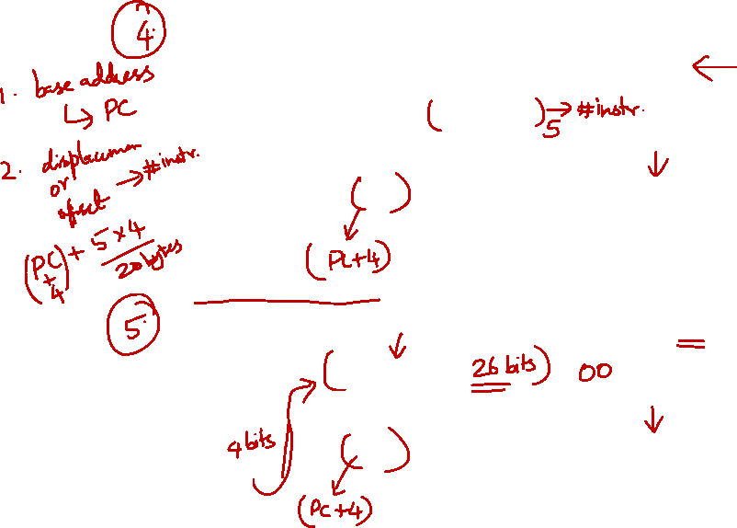
8. Addressing Modes (3/3)
PC-relative addressing: address is sum of PC and constant in the instruction (beq, bne)
Memory
op
rs
rt
Address
MIPS:
beq, bne
PC
+
word
Pseudo-direct addressing: 26-bit of instruction concatenated with upper 4-bits of PC (j)
Memory
op
Address
MIPS:
j
PC
:
word

Slide 45
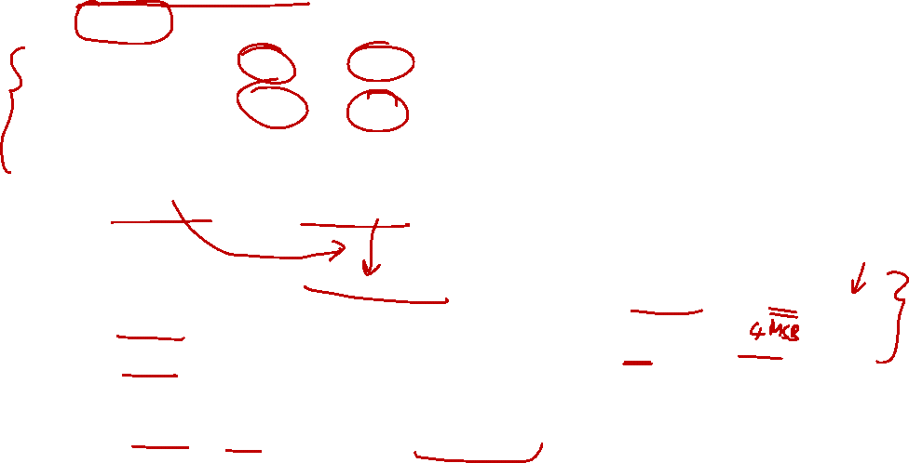
Summary (1/2)
MIPS Instruction: 32 bits representing a single instruction
R
opcode
rs
rt
rd
shamt
funct
I
opcode
rs
rt
immediate
J
opcode
target address
Branches and load/store are both I-format instructions; but branches use PC-relative addressing, whereas load/store use base addressing
Branches use PC-relative addressing Jumps use pseudo-direct addressing
Shifts use R-format, but other immediate instructions (addi, andi, ori) use I-format
IN OTHER WORDS:
beq, bne: ignore PC, count displacement
j: use PC, ignore displacement

Slide 46
Summary (2/2)

Slide 47
End of File

